Slide 1

Consumer Behavior: Buying, Having, and Being
Twelfth Edition
Chapter 6
The Self: Mind, Gender, and Body
Copyright © 2017, 2015, 2013 Pearson Education, Inc. All Rights Reserved.
Notes:
If this PowerPoint presentation contains mathematical equations, you may need to check that your computer has the following installed:
1) MathType Plugin
2) Math Player (free versions available)
3) NVDA Reader (free versions available)
This chapter defines the scope of international business and introduces us to some of its most important topics.

Slide 2
Learning Objectives
6.1 The self-concept strongly influences consumer behavior.
6.2 Products often define a person’s self-concept.
6.3 Gender identity is an important component of a consumer’s self concept.
6.4 The way we think about our bodies (and the way our culture tells us we should think) is a key component of self-esteem.
6.5 Every culture dictates certain types of body decoration or mutilation.

Slide 3

Learning Objective 6.1
The self-concept strongly influences consumer behavior.
Notes:
In our first objective, we learn about the meaning of self-concept.

Slide 4
What Is Self-Concept?
Self-concept summarizes the beliefs a person holds about his own attributes and how he evaluates the self on these qualities.
Collective Self
Identity
Notes:
Although your overall self-concept may be positive, there certainly are parts of it you evaluate more positively than others. The self-concept is a very complex structure. We describe attributes of self-concept along such dimensions as content (e.g., facial attractiveness versus mental aptitude), positivity (i.e., self-esteem), intensity and stability over time, and accuracy (i.e., the Degree to which one’s self-assessment corresponds to reality).
Collective self, where a person derives his or her identity in large measure from a social group.
Identity is any category label with which a consumer self-associates that is amenable to a clear picture of what a person in that category looks like, thinks, feels and does.

Slide 5
What Is Self-Esteem?
Self-esteem refers to the positivity of a person’s self-concept. People with low self-esteem expect that they will not perform very well, and they will try to avoid embarrassment, failure, and rejection.
Social comparison
Notes:
When it developed a new line of snack cakes, Sara Lee found that consumers low in self-esteem preferred portion-controlled snack items because they felt they lacked self-control.8 In contrast, a more recent study found that individuals who are made to feel powerful spend more money on themselves (“because I’m worth it!”), whereas those who experience a feeling of powerlessness spend more on others than on themselves.
Social comparison is when a person tries to evaluate her appearance by comparing it to the people depicted in these artificial images.

Slide 6
Real and Ideal Selves
Ideal self: our conception of how we would like to be
Actual self: our more realistic appraisal of the qualities we have
Products can:
Help us reach ideal self
Be consistent with actual self
Impression management means that we work to “manage” what others think of us
Notes:
We choose some products because we think they are consistent with our actual self, while we buy others to help us reach an ideal standard. We may strategically choose clothing and other products to show off to others. In other words, we are managing their impression of us with our product choices.

Slide 7
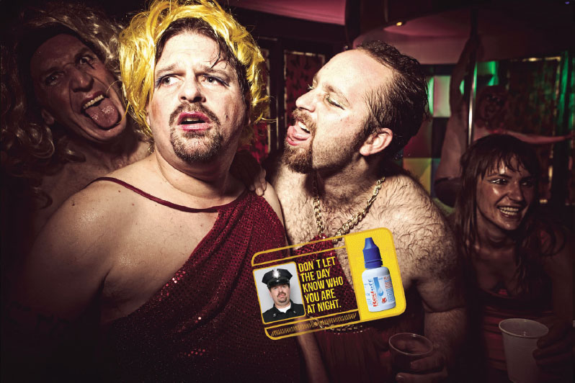
Multiple Selves (1 of 2)
Marketers pitch products needed to facilitate active role identities.
Notes:
We all have multiple roles we play in our lives. We may have as many selves as we do different social roles. If each person potentially has many social selves, how does each develop? How do we decide which to activate at any point in time? Symbolic interactionism stresses that relationships with other people play a large part in forming the self.

Slide 8
Multiple Selves (2 of 2)
Behavioral learning theories focus on stimulus-response connections
Cognitive theories focus on consumers as problem solvers who learn when they observe relationships
Notes:
The dramaturgical perspective on consumer behavior views people as actors who
play different roles.
Torn self, where respondents struggle with retaining an authentic culture while still enjoying Western freedom (and dealing with assumptions of others who believe they might be terrorists).
Symbolic interactionism stresses that relationships with other people play a large part to form
the self.

Slide 9
Looking-Glass Self
Notes:
Sociologists call the process of imagining others’ reactions “taking the role of the other,” or the looking-glass self. According to this view, our desire to define ourselves operates as a sort of psychological sonar: We take readings of our own identity when we “bounce” signals off others and try to project their impression of us. Like the distorted mirrors in a funhouse, our appraisal of who we are varies depending on whose perspective we consider and how accurately we predict their evaluations of us. A confident career woman may sit morosely at a nightclub, imagining that others see her as a dowdy, unattractive woman with little sex appeal (regardless of whether these perceptions are true). A self-fulfilling prophecy like the one we described comes into play here because these “signals” influence the woman’s actual behavior.

Slide 10
Self-Consciousness
Public self-consciousness
Self monitors
Selfie
Meerkating
Empty self
Notes:
Public self-consciousness relates to the extent in which a person expresses interest in clothing and the use of cosmetics.
High self-monitors are more attuned to how they present themselves in their social environments, and their estimates of how others will perceive their product choices influence what they choose to buy.
A selfie, or a picture a smartphone user takes of himself or herself on a smartphone (whether or not it’s attached to a “selfie stick”) is a common form of communication, especially for Millennials.
Meerkating describes the act of someone shooting a live video stream, has become a verb as
thousands of people create their own running self-documentaries.
Empty self relates to the decline of shared points of reference over the last 50 years as we witnessed a decline in family, community, and traditions.

Slide 11
You Are What You Consume
Social identity as individual consumption behaviors
Question: Who am I now?
Answer: To some extent, your possessions!
Inference of personality based on consumption patterns
People who have an incomplete self-definition complete the identity by acquisition
Symbolic self-completion theory
Notes:
Identity marketing is a promotional strategy where consumers alter some aspects of their selves to advertise for a branded product.
For instance, Air New Zealand created “cranial billboards” in exchange for a round-trip ticket to New Zealand. 30 participants shaved their heads and walked around with an ad for the airline on their skulls. The Casa Sanchez restaurant in San Francisco gives free lunches for life to anyone who gets its logo tattooed on their body. The restaurant estimates that the cost of the identity marketing promotion is $5.8 million – in terms of the free lunches redeemed. The image shown in the slide is the Casa Sanchez tattoo on a loyal customer.
The reflected self helps shape self-concept, which implies that people see themselves as they imagine others see them. Because what others see includes a person’s clothing, jewelry, furniture, car, and so on, it stands to reason that these products also help to create the perceived self. A consumer’s possessions place her into a social role which helps to answer the question, “Who am I now?”
People use an individual’s consumption behaviors to identify that person’s social identity. In addition to looking at clothes and grooming habits, we make inferences about personality based on choices of leisure activities, food preferences, and home decorating choices.
When we use objects to maintain our self-concept, we tend to become attached to those objects. For example, someone who drives a Mini Cooper may rely upon the image of Mini to relay information about his or her own identity (as a fun, distinctive, stylish person). The more the person relies upon the possession as a way of defining and supporting his or her identity, the more attached the person will be to the possession.
Symbolic self-completion theory suggests that people who have an incomplete self-definition tend to complete this identity when they acquire and display symbols they associate with that role.

Slide 12
Self/Product Congruence
Consumers demonstrate their values through their purchase behavior
Self-image congruence models: we choose products when attributes matches the self
Product Usage = Self-Image
Notes:
Research supports this idea that there is a match between product usage and self-image. In one study, car owners’ rating of themselves tended to match their perceptions of their cars. In another study, observers were able to match photos of male and female drivers to the cars they drove 70% of the time.

Slide 13
For Reflection (1 of 5)
Advertising can utilize a consumer’s self-esteem in promoting a product by offering the product as a remedy to low self-esteem. Self-esteem advertising: products provide remedy to low self-esteem.
How effective do you think this form of advertising is?

Slide 14
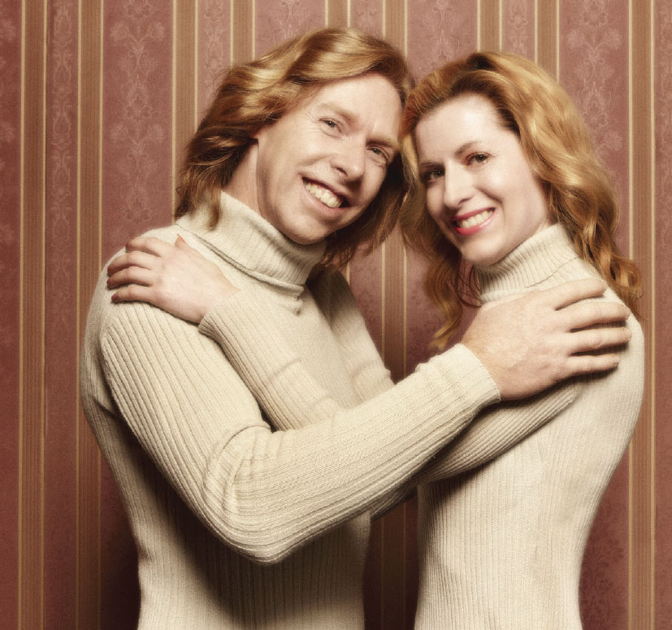
Learning Objective 6.2
Products often define a person’s self-concept.
Notes:
A spouse often becomes part of a person’s extended self- for better or worse.

Slide 15
The Levels of the Extended Self
Individual: personal possessions (cars, clothing)
Family: residence and furnishings
Community: neighborhood or town where you live
Group: social or other groups
Notes:
The external objects that we consider a part of us make up our extended selves. Many material objects can help to form a person’s identity.

Slide 16
Embodied Cognition
Power posing
Enclothed cognition
Notes:
Embodied cognition relates to the state of the body modifying states of the mind.
Power posing is standing in a confident way even if you don’t feel confident, which affects brain activity.
Enclothed cognition shows how the symbolic meaning of clothing changes how people
behave.

Slide 17
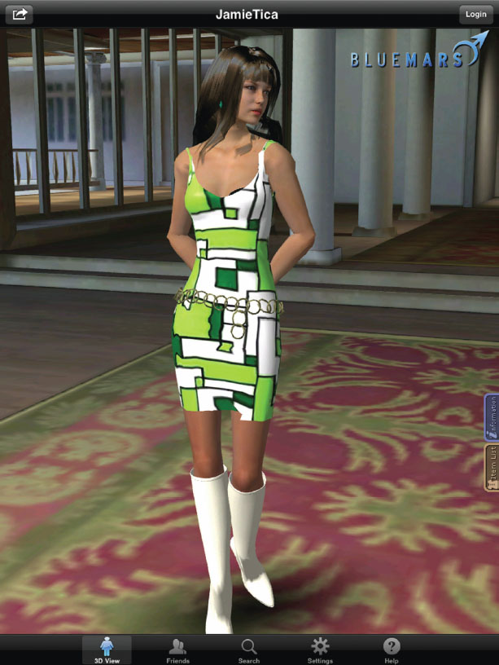
The Digital Self
Wearable computing
Virtual makeover
Notes:
People can construct digital versions of their selves online. We use digital footprints, lifestreams, and profiles to do this.
Wearable computing are when we wear devices on our wrist like the Apple Watch.
Virtual makeovers are platforms that allow the shopper to superimpose images on their faces or bodies so that they can quickly and easily see how products would alter appearance, without taking the risk of actually buying the item first.

Slide 18
For Reflection (2 of 5)
Construct a “consumption biography” of a friend, family member, or classmate.
Make a list of his/her most favorite possessions, and see if you or others can describe this person’s personality just from the information provided by this catalogue.

Slide 19
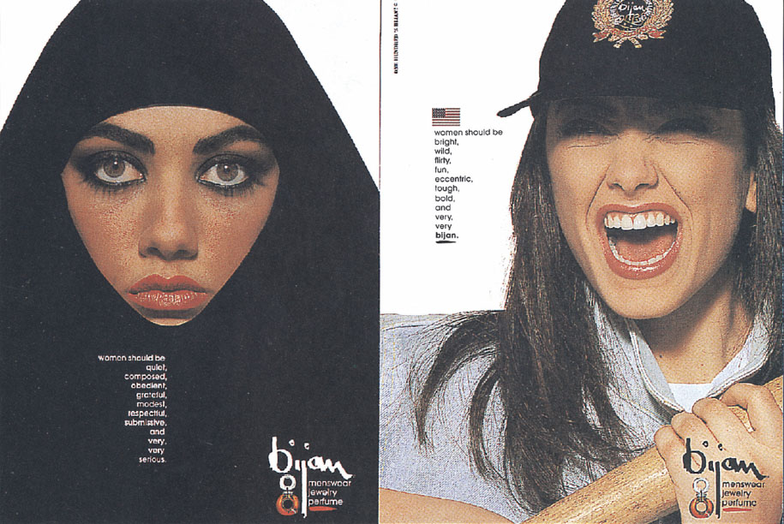
Learning Objective 6.3
Gender identity is an important component of a consumer’s self-concept.
Notes:
Our second objective in this chapter focuses on gender as a part of our consumer identity. This ad for Bijan illustrates how sex-role identities are culturally bound by contrasting the expectations of how women should appear in two different countries.

Slide 20
Gender Differences in Socialization
Gender roles vary by culture but are changing
Many societies still expect traditional roles:
Agentic roles: men are expected to be assertive and have certain skills
Communal roles: women are taught to foster harmonious relationships
Notes:
Gender roles do vary by culture and they shift as culture shifts. Many of our gender roles are socialized by marketing. For instance, the Bratz line of dolls licenses its name to a cosmetics line targeted to girls ages 6 to 9.
Gender identity is an important component of a consumer’s self-concept. People often conform to their culture’s expectations about how those of their gender should act, dress, or speak; we refer to these sets of expectations as sex roles.
Many societies expect males to pursue agentic goals, which stress self-assertion and mastery. However, they teach females to value communal goals, such as affiliation and building harmonious relations.

Slide 21
Sex-Typed Traits and Products
Sex-typed traits: characteristics we stereotypically associate with one gender or the other.
Sex-types products: take on masculine or feminine attributes
Princess telephones
Thor’s Hammer vodka
Notes:
Many products are sex-typed. They take on masculine or feminine attributes and consumers associate them with one gender or another. Thor’s Hammer vodka brand comes in a short, squat bottle and it is described as “bold, broad, and solid – this is a man’s vodka.”
Both men and women have typical sex roles. Masculinism is the study of male image and its complex cultural meanings. There are three traditional models of masculinity: 1) breadwinner, 2) rebel, and 3) man of action hero. The breadwinner model is based on the American view of success. The rebel model emphasizes rebellion, independence, adventure, and potency. The man-of-action hero draws from the better of the other two models. Men and women receive mixed messages about how they are supposed to behave and feel.

Slide 22
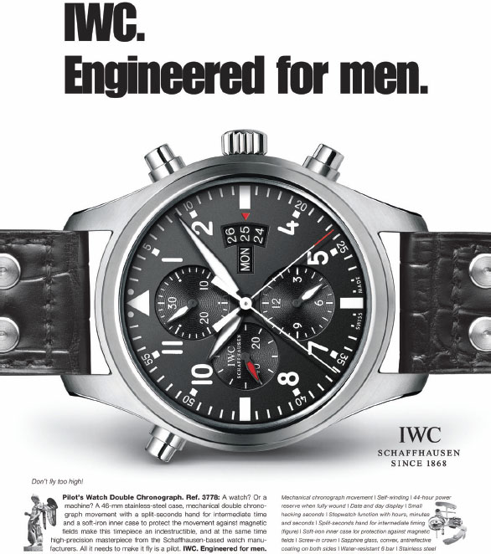
Sexual Identity (1 of 2)
Neuroendocrinological science
Bromance
Masculinism
Androgyny
Notes:
Neuroendocrinological science focuses on the potential role of hormonal influences on preferences for different kinds of products or people.
Bromance (affection between straight male friends).
Masculinism is the study the male image and the complex cultural meanings of masculinity.
Androgyny refers to the possession of both masculine and feminine traits.

Slide 23
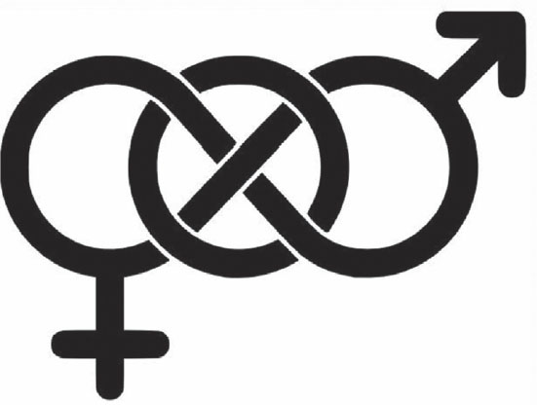
Sexual Identity (2 of 2)
Third-gender movement
Intersex children
Notes:
Our definitions of gender continue to evolve as a global third-gender movement picks up steam: Australia’s High Court recently ruled that a person there was allowed to register gender as “nonspecific” on official documents.
Intersex children — those born with both genitals, or ambiguous sex characteristics.

Slide 24
For Reflection (3 of 5)
What are two examples of sex-typed products?
Are there situations for which promoting sex-typed products might limit the market for a product?

Slide 25
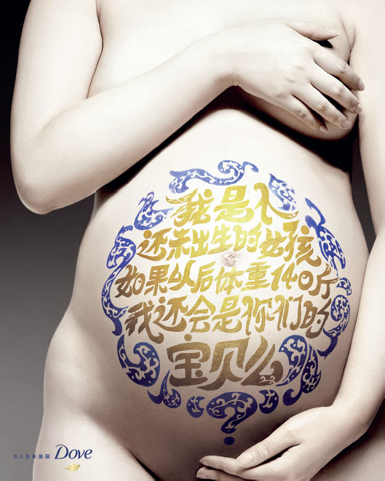
Learning Objective 6.4
The way we think about our bodies (and the way our culture tells us we should think) is a key component of self-esteem.
Notes:
In this next section, we’ll learn about body image. A person’s physical image is a large part of his or her self-concept. Body image refers to a consumer’s subjective evaluation of his physical self. As with a person’s overall self-concept, this image is not necessarily accurate.
Body cathexis refers to a person’s feelings about his body. The word cathexis refers to the emotional significance of some object or idea. Consumers who are more satisfied with their bodies are more frequent users of preening products like blow dryers, cologne, and facial bronzers.

Slide 26
Ideals of Beauty
Exemplar of appearance
“What is beautiful is good” stereotype
Favorable physical features:
Attractive faces
Good health and youth
Balance/symmetry
Feminine curves/hourglass body shape
“Strong” male features
Notes:
Virtually every culture has a beauty bias. Preferences for some genetic features are genetic rather than cultural – like large eyes, high cheekbones, and a narrow jaw.

Slide 27
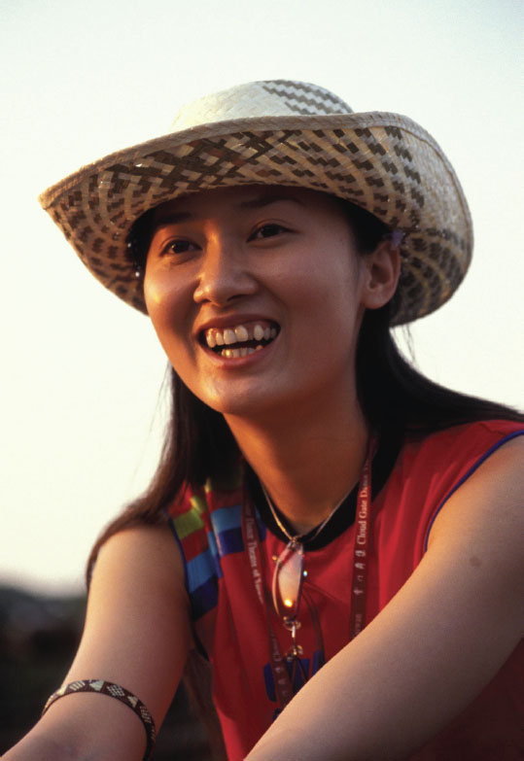
Today’s Ideal Female Body
Body image distortions
Vanity sizing
Fattism
Notes:
Women in particular tend to pick up messages from the media that the quality of
their bodies reflects their self-worth, so it is not surprising that most (though certainly not all)
major body image distortions occur among females. These psychological disorders cause
the patient to believe that his or her body literally is bigger or smaller than others see it.
Clothing manufacturers often offer vanity sizing, where they deliberately assign smaller
sizes to garments.
Fattism is deeply ingrained in our culture: As early as nursery school age, children prefer drawings of peers in wheelchairs, on crutches, or with facial disfigurements to those of fat children. Society is obsessed with weight. Though it began as America’s obsession, the cultural priority on thinness is spreading to other countries. Still, even with the ideal of thin, the U.S. consumer today is larger than 60 years ago. The typical woman’s body is not as petite as it used to be.

Slide 28
For Reflection (4 of 5)
What is considered the ideal of beauty among your peers?
How does this ideal affect your choices as a consumer?
Notes:
The Western ideal of beauty is based on cues such as skin color, eye shape, and other aesthetic cues. We can see the manifestation of this ideal of beauty in products like Pond’s Skin Lightening Moisturizer and colored contacts. Have you seen a shift in what is considered beautiful among your friends over time?

Slide 29
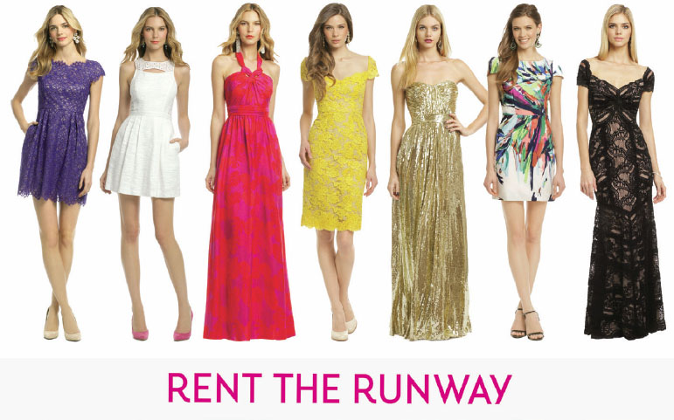
Learning Objective 6.5
Every culture dictates certain types of body decoration or mutilation.

Slide 30
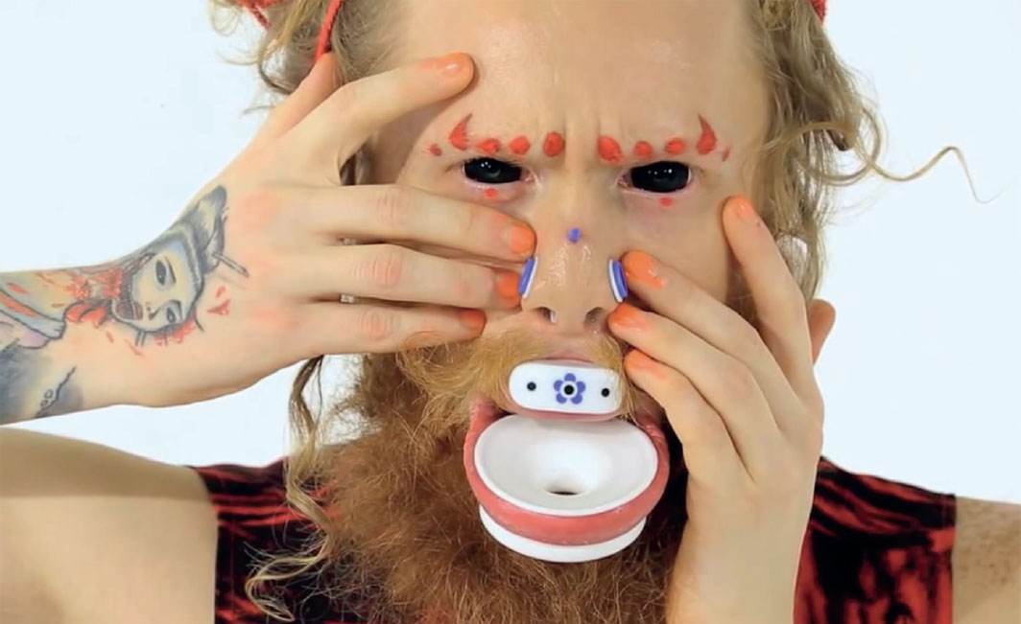
Working on the Body
Body anxiety
Cosmetic surgery
Body decoration and mutilation
Body piercing
Notes:
Consumers increasingly choose to have cosmetic surgery to change a poor body image or to enhance appearance. These may include breast augmentation, liposuction, nose jobs, face lifts, and other enhancements.
Decorating the self can serve several purposes. Some of these are to:
Distinguish group members from nonmembers
Place the individual in the social organization
Place the person in a gender category
Enhance sex-role identification
Indicate desired social conduct
Indicate high status or rank
Provide a sense of security

Slide 31
For Reflection (5 of 5)
Do you have a tattoo? If so, what motivated your decision? If not, why not?
Can you see the influence of culture on your decision to tattoo or not?

Slide 32
Chapter Summary
Self-concept as an influence on behavior
The role of products in defining self-concept.
Gender identity is an important component of a consumer’s self concept.
The way we think about our bodies influences self-esteem.
Body mutilation is a way we decorate our bodies.
Notes:
We’ve covered several key concepts in this chapter. You should now understand that self-concept strongly influences our behavior as consumers and that products can play a pivotal role in defining our self-concept. Society’s expectations of masculinity and femininity help to determine the products we buy in that we seek to be consistent with expectations. The way we think about our bodies is a key component of our self-esteem. Every culture has norms for beauty which will influence how we view our bodies and decorate ourselves.

Slide 33

Copyright

